Slide 1
Chariot through time
By Jennifer Ryan & S. Alice Winteler

Slide 2
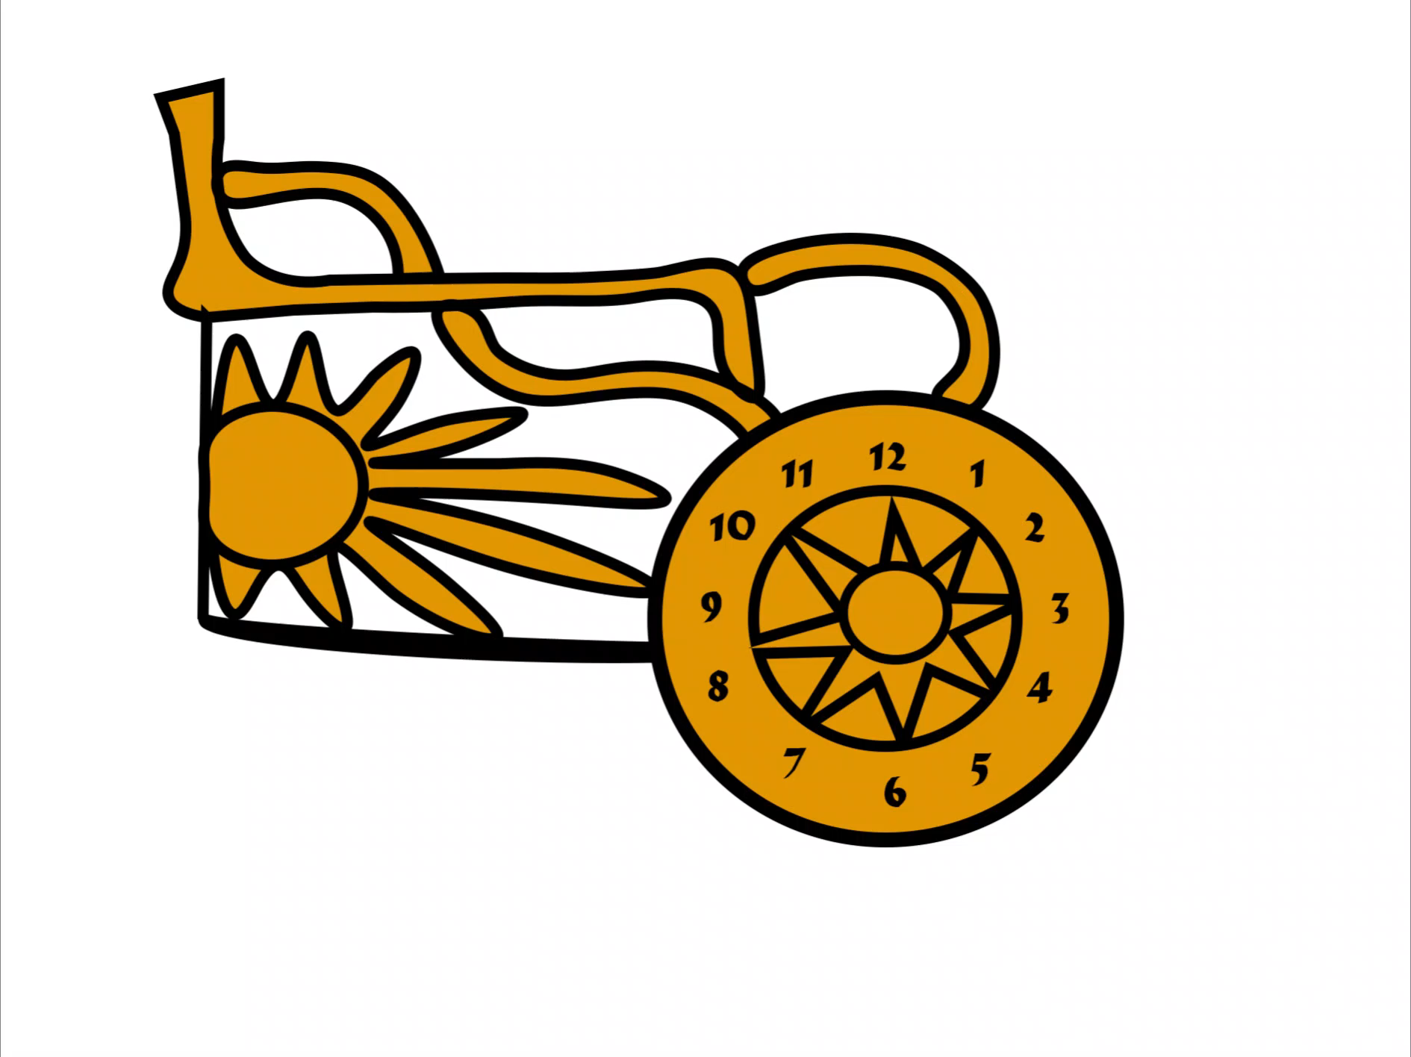
Chariot Through Time
Story
Problems
Greek Mythology
21st Century Demigod
Apollo has angered Zeus
Player is getting punished
Goal: Confront Zeus to return to 2020
Blender Issues
Unable to import objects with Materials
Photoshop Issues
Adding Animation
Future Plan
Logo
Add opponents
Add Blender objects and more collectibles
Add more Levels
Cloud Gaming
Google Cloud
Private Server
Voice Control
Simple Commands
‚Open‘, ‚Attack‘, ‚Loot‘
Greek Chariot
Based on Apollo‘s Sun Chariot
Clock Animation

